Slide 1

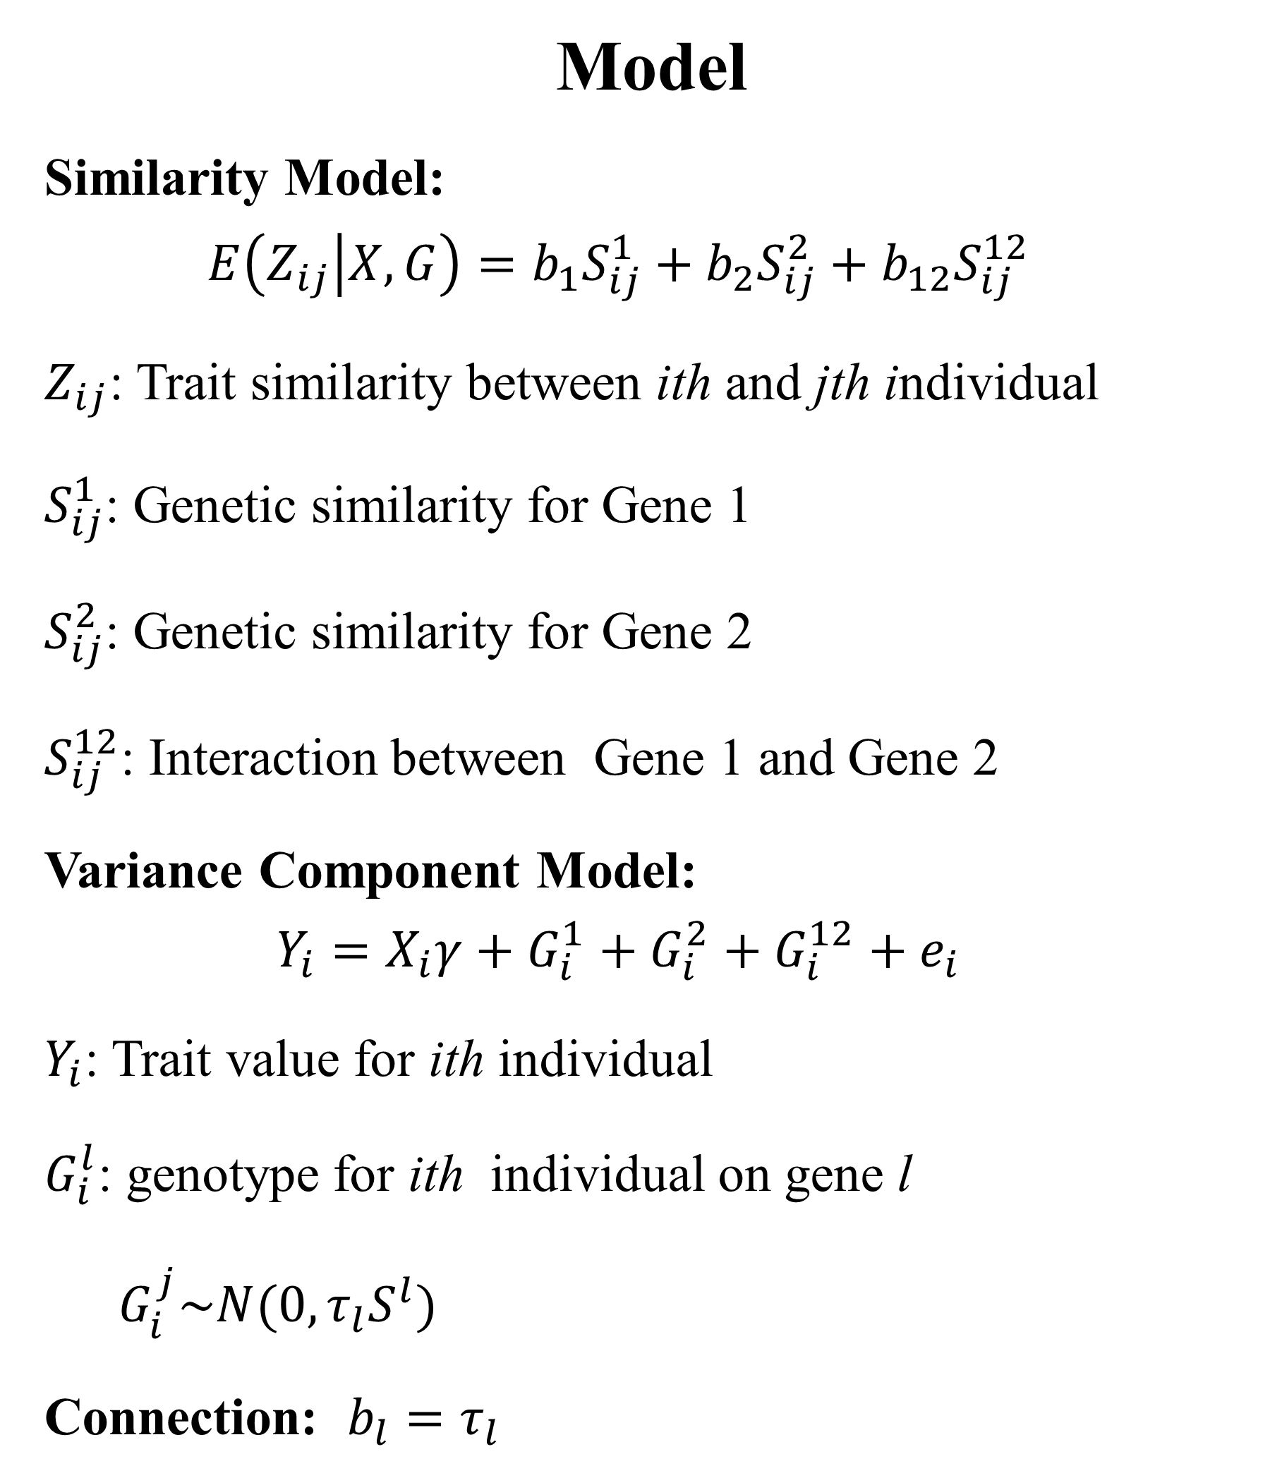
NC STATE UNIVERSITY
Gene-set Analysis For Gene-Gene Interactions Using Gene-Trait Similarity Regression
Xin Wang and Jung-Ying Tzeng
Bioinformatics Research Center, North Carolina State University, Raleigh, NC 27695
Introduction
Gene-set analysis has drawn great attention in recent genome-wide and sequence-based association studies. While most gene-set methods have concentrated on detecting genetic main effects, here we focus on methods for studying gene-gene (GxG) interactions. The gene-set GxG method we present focuses on quantitative traits and uses pairwise genetic similarity as a tool to aggregate marker information.
Growth Does Not Differ by Sex
80
= male
= female
60
Body Weight (g)
40
20
Objective
Develop a framework for incorporating gene-gene interaction effects in similarity-based methods.
Propose a series of tests to suit different purposes
  test for detecting GxG interactions
  test for detecting marginal main effects for one gene adjust by the other gene
  joint test for detecting the overall association induced either by genetic main effects or by GxG interactions.
0
31
6
28
23
31
6
18
23
28
Temperature (°C)
Results
Sex was discernible in most fish greater than 120 mm long.
High (28ºC) temperature produced 4% females.
Low (18ºC) temperature produced 22% females.
Mid-range (23ºC) temperature produced 44% females.
Fish raised at high or low temperatures showed reduced growth compared to those at the mid-range temperature.
Up to 245 days, no differences in growth existed between sexes.
 
Rearing Temperature Affects Growth
80
Conclusions
These findings indicate that sex determination in southern flounder is temperature-sensitive and temperature has a profound effect on growth.
A mid-range rearing temperature (23°C) appears to maximize the number of females and promote better growth in young southern flounder.
Although adult females are known to grow larger than males, no difference in growth between sexes occurred in age-0 (< 1 year) southern flounder.
60
Body Weight (g)
 
40
20
0
37
51
37
Acknowledgements
The authors acknowledge the Salstonstall-Kennedy Program of the National Marine Fisheries Service and the University of North Carolina Sea Grant College Program for funding this research. Special thanks to Lea Ware and Beth Shimps for help with the work.
18
23
28
Temperature (ºC)

